Slide 1

ELECTRONIC TABLETS
By
Ch V Naga Sowjanya

Slide 2




ABOUT ME
Masters of Technology
To implement in my core field and high package since this is the boom
Projects using MATLAB

Slide 3
AGENDA
Problem Statement
Web-Scraping Websites
Data Cleaning & Data Manipulation
Uni- Variant Analysis
Bi-Variant Analysis
Multi Variant Analysis
Conclusions

Slide 4
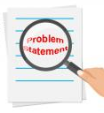
To find where we have more options to buy and how the prices vary with respect to the features of the Electronic TABLETS (tabs)

Slide 5



Slide 6
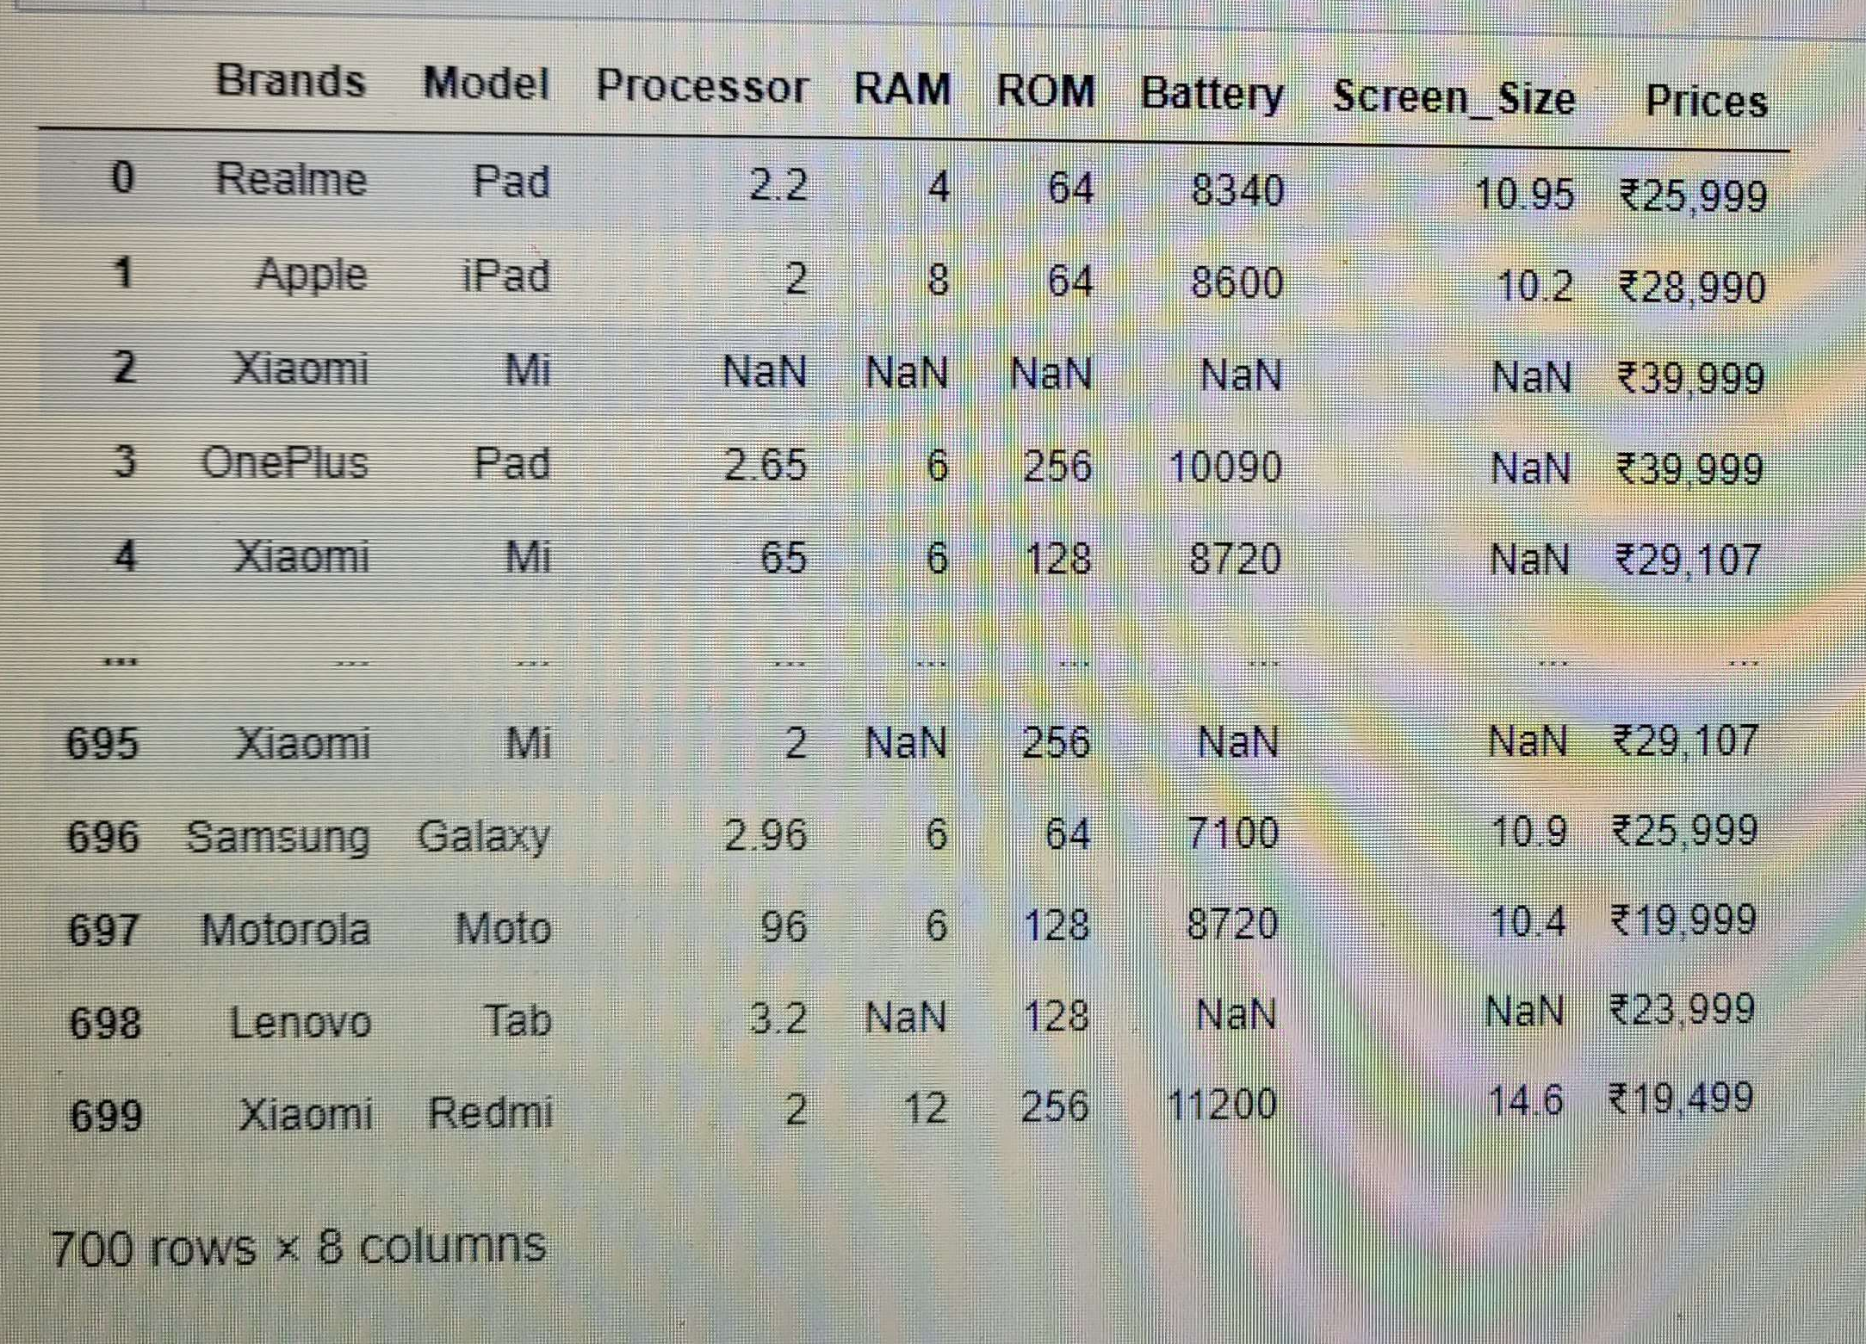
Data Cleaning

Slide 7
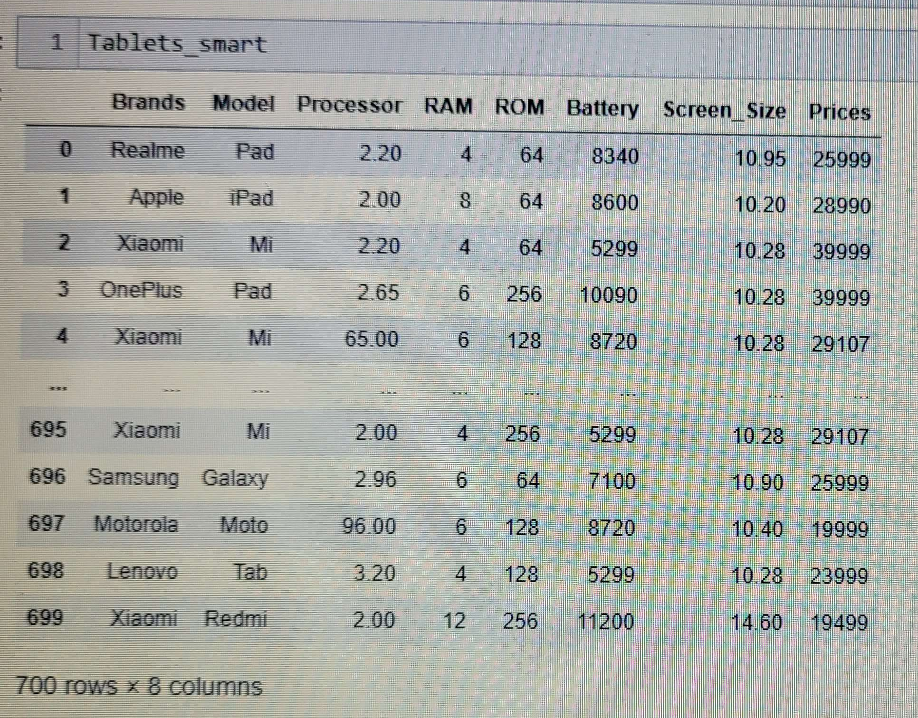
Data Manipulation

Slide 8
Uni – Variant Analysis
SMARTPRIX

Slide 9
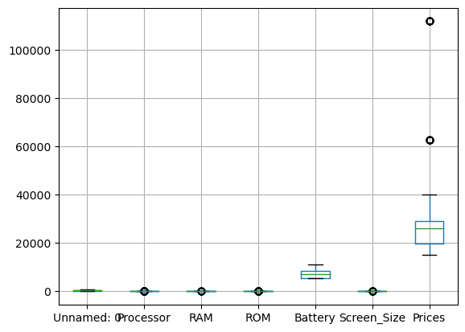
Visually we can say that SmartPrix data are containing Outliers with respect to Prices

Slide 10
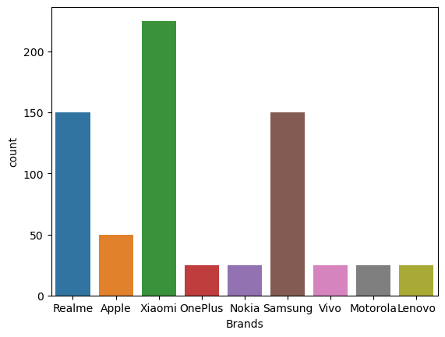
SmartPrix data contains more Xiaomi Brands followed by Realme and Samsung Brands has equal number when compared to remaining Brands

Slide 11
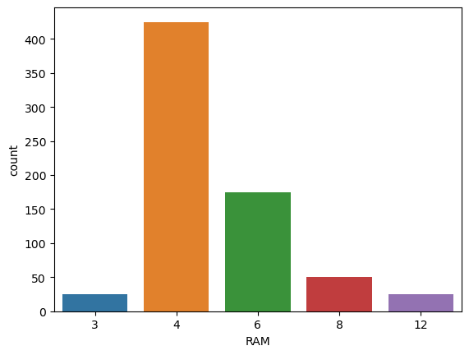
Tabs in SmartPrix data contains more 4GB RAM when compare to 6,8,3 and 12GB RAM's

Slide 12
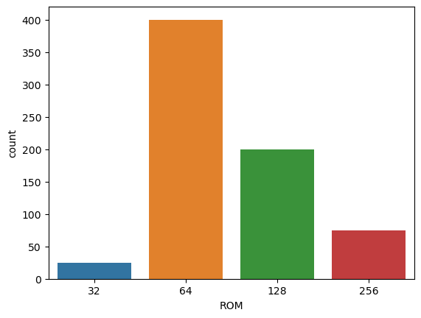
Tabs in SmartPrix data contains more 64GB ROM when compare to 32,128 and 256GB ROM's

Slide 13
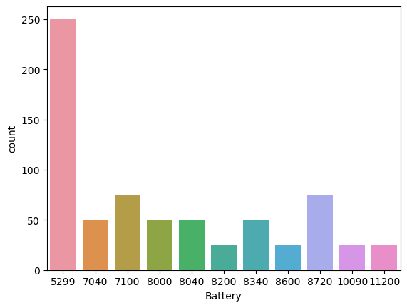
Tabs in SmartPrix data contains more 5299 mAh Battery when compare to remaining Batteries

Slide 14
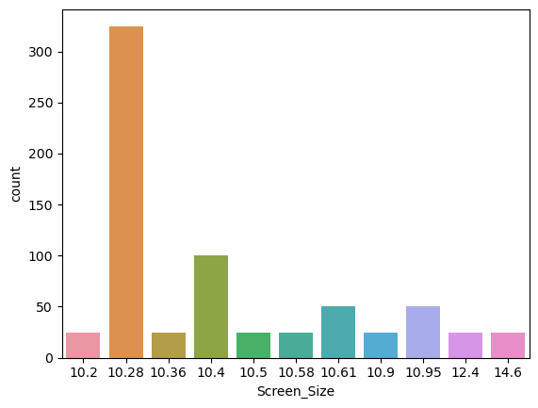
Tabs in SmartPrix data contains more 10.28 inches of Screen Size when compare to remaining Screen Size

Slide 15
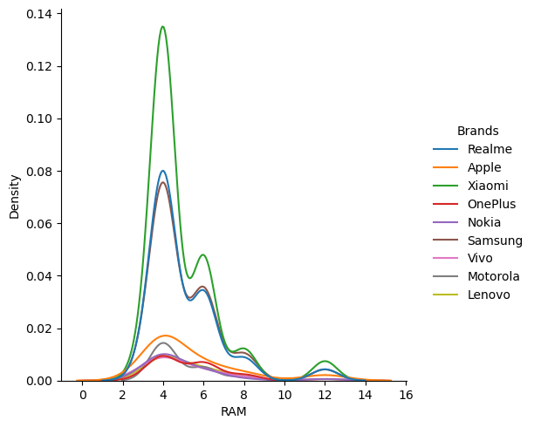
In SmartPrix data most of the Tabs are containing 2 to 6GB RAM and small cluster of Tabs are under 12GB RAM
Xiaomi Brand is distributed more at 4GB RAM when compare to remaining Brands

Slide 16
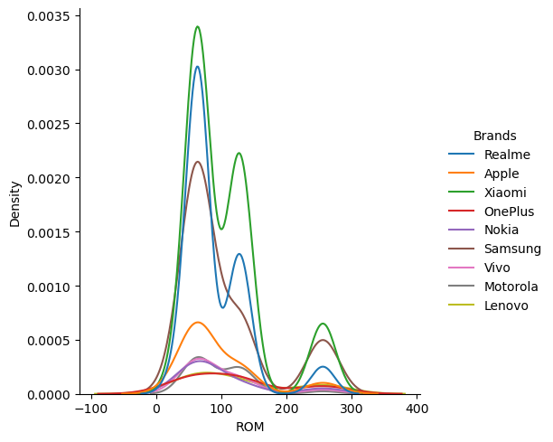
In SmartPrix data most of the Tabs are containing 64 to 128GB ROM and small cluster of Tabs are under 256GB ROM
Xiaomi Brand is distributed more at 64GB ROM when compare to remaining Brands

Slide 17
Bi– Variant Analysis
SMARTPRIX

Slide 18
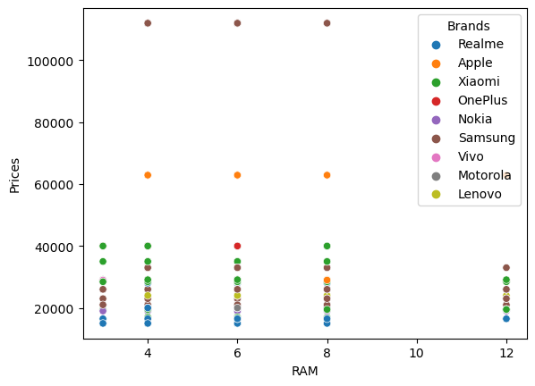
The Variation in Prices are not that much affected even there is an increase in RAM but we can observe some outliers in SmartPrix data

Slide 19
Multi– Variant Analysis
SMARTPRIX

Slide 20
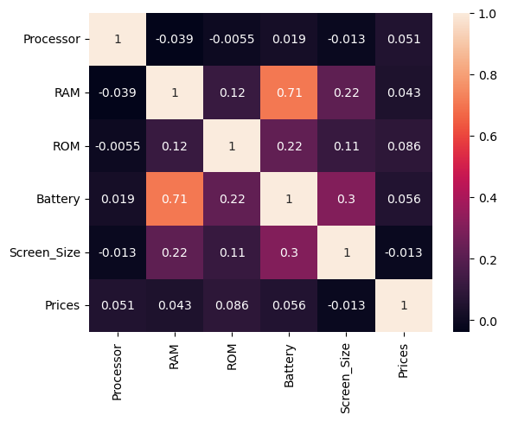
Highest Positive Correlation is maintained between Battery and RAM and
Slight Positive Correlation is maintained between Battery and Screen Size for SmartPrix data

Slide 21
Uni – Variant Analysis
FLIPKART

Slide 22
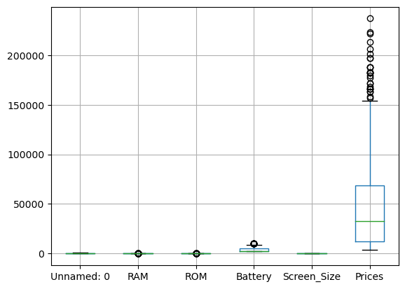
Visually we can say that Flipkart data are containing Outliers with respect to Prices

Slide 23
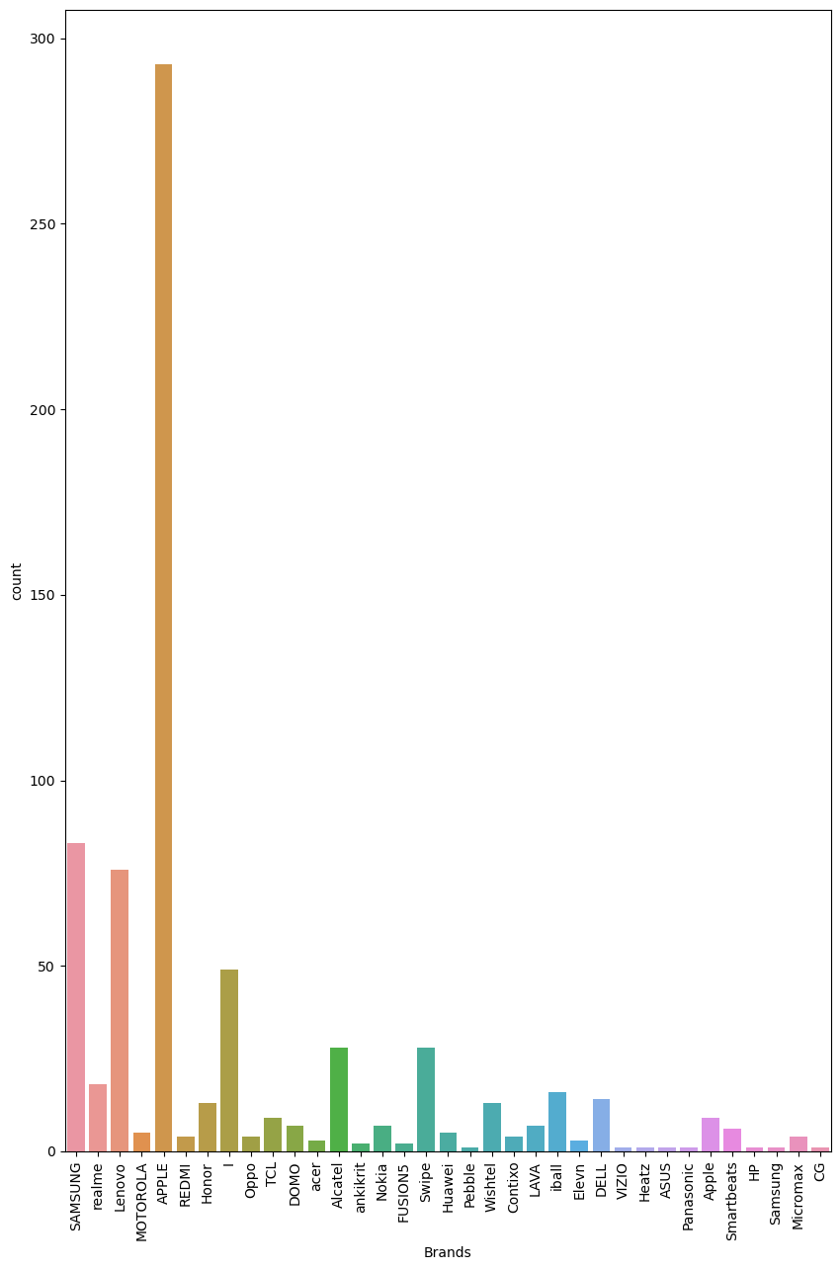
Flipkart data contains more Apple Brands followed by Samsung and Lenovo Brands when compared to remaining Brands

Slide 24
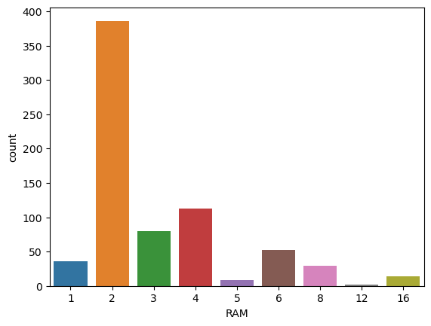
Tabs in Flipkart data contains more 2GB RAM when compare to remaining RAM's

Slide 25
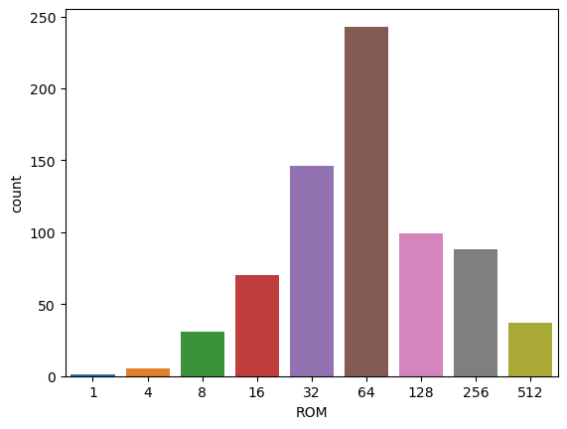
Tabs in Flipkart data contains more 64GB ROM when compare to remaining ROM's

Slide 26
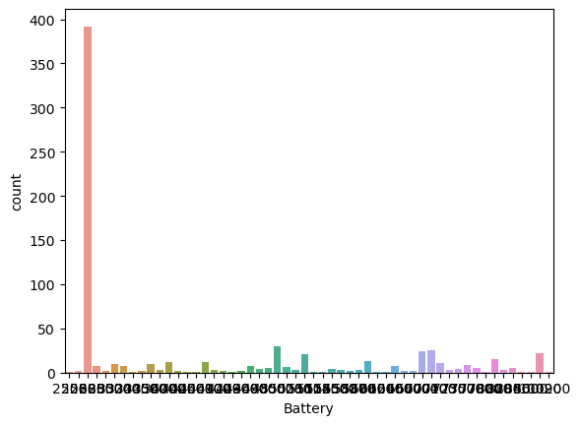
Tabs in Flipkart data contains more 5299 mAh Battery when compare to remaining Batteries

Slide 27
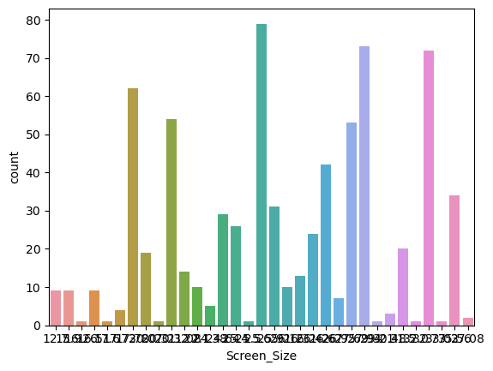
Tabs in SmartPrix data contains more 10.28 inches of Screen Size when compare to remaining Screen Size

Slide 28
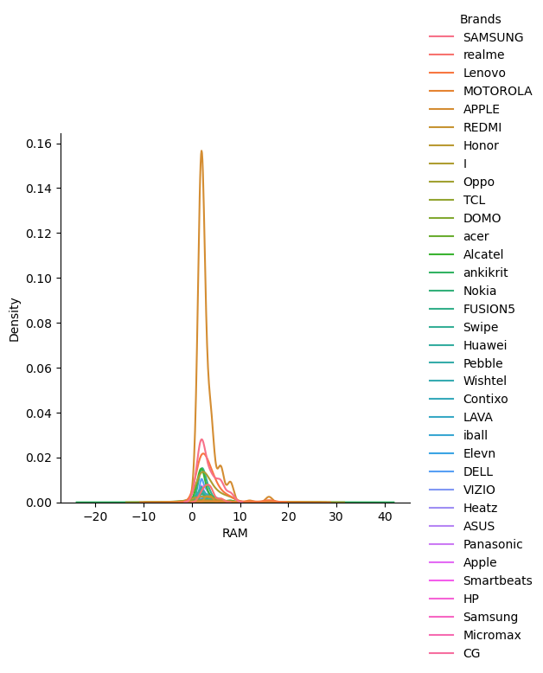
In Flipkart data most of the Tabs are containing 2GB RAM and very small cluster of Tabs are under 16GB RAM
Redmi Brand is distributed more at 3GB RAM when compare to remaining Brands

Slide 29
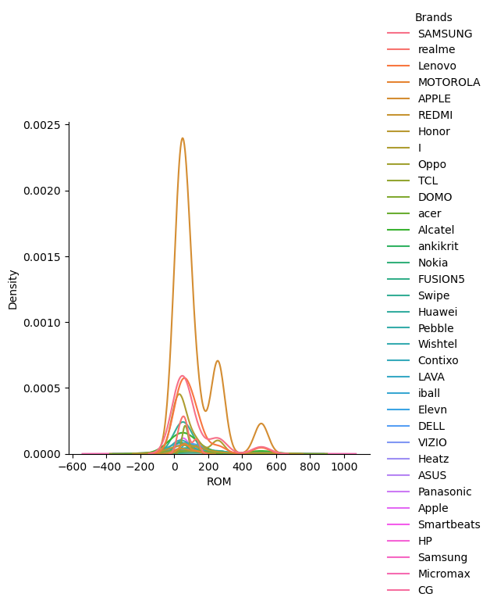
In Flipkart data most of the Tabs are containing 32 to 128GB ROM and small cluster of Tabs are under 256 and 512GB ROM
Redmi Brand is distributed more at 64GB ROM when compare to remaining Brands

Slide 30
Bi– Variant Analysis
FLIPKART

Slide 31
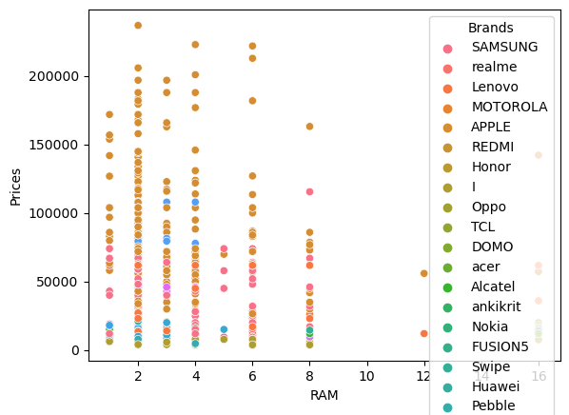
The Variation in Prices are not that much affected even there is an increase in RAM but we can observe some outliers in Flipkart data

Slide 32
Multi– Variant Analysis
FLIPKART

Slide 33
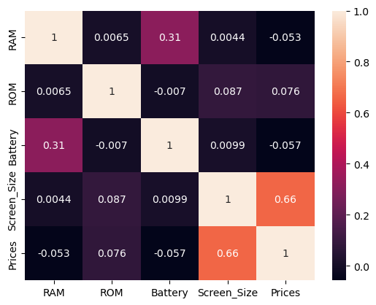
Highest Positive Correlation is maintained between Screen Size and Price and
Slight Positive Correlation is maintained between Battery and RAM for Flipkart data

Slide 34
CONCLUSIONS

Slide 35
From this data I can Conclude that more options are available in Flipkart based on Brands.
Prices doesn’t effect more wrt to RAM & ROM but Price is effected wrt Screen Size for Flipkart data.
Battery and RAM is more effected for both SmartPrix and Flipkart data.
Middle class customers and high class customers both can refer Flipkart for buying Electronic Tablets.

Slide 36


Slide 37


